Slide 1


MACHINE LEARNING
MASTER CLASS
DAY – 6/30
Titanic Survival Prediction – Naïve Bayes

Slide 2

01
Titanic Survival Prediction – Naïve Bayes
Concept

Slide 3

02
Titanic Survival Prediction – Naïve Bayes
Project

Slide 4
The Psychology of Money
-Morgan Housel
🧠Book Suggestion💡

Slide 5
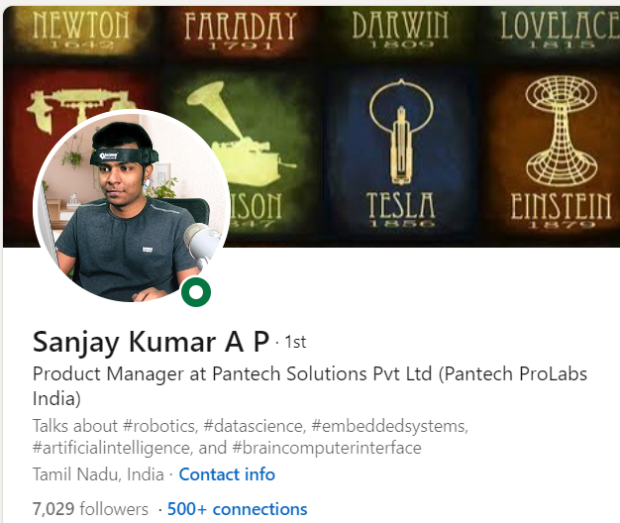
THANKS!
DO YOU HAVE ANY QUESTIONS?
Do you have
Course related questions?
+91 9363083283
Pantechsolutions.net
Follow Me on the LinkedIn – Link in Description

